Slide 1
DHS | OIG - Background Studies Division
Dawn Davis| Deputy Inspector General

Slide 2
Data Overviews 1 and 2 (Completed)
Background Studies
Total Determinations (395,325)
Distinct Persons (367,790)
Overview 2: Count of distinct persons by background study risk of harm determination, provider type and race/ethnicity
Eligible (96.5%)
Disqualifying (3.5%)
Distinct Persons with Disqualifying Determinations (3.5%)
DHS (54%)
DHS (50%)
No Supervision (30%)
Supervision (37%)
MDH (56%)
MDH (30.5%)
Immediate Removal (11%)
DOC (0.5%)
DOC (<0.3%)
Must Have Clearance or Set Aside to Work (34%)
Notes:
Overview 1: Count of distinct persons with eligible and disqualifying determinations by provider type and race/ethnicity

Slide 3
Data Overviews 3 and 4 (In Progress)
Background Studies
Disqualifying Determinations (20,611 [5%])
Overview 4: Count of determinations with requests for reconsideration by outcome, race/ethnicity and gender
Total Crimes and Conduct (≈30,000)
Conviction
Crimes and Conduct by Type and Years Disqualifying
Reconsideration Requested
Reconsideration Not Requested
Admission
ROH
Alford Plea
Determination Correctness
Preponderance of the Evidence
Serious/Recurring Maltreatment
Rescinded
Set Aside
Involuntary Termination of Parental Rights
Not Set Aside Variance Granted
Upheld
Not Set Aside
Administrative Disqualification
Adjudicated Delinquent
Administrative Hearing or Court of Appeals
Notes:
Overview 3: Count of disqualifying crimes and conduct by disposition type, years disqualifying, and crime or conduct type, race/ethnicity and gender

Slide 4
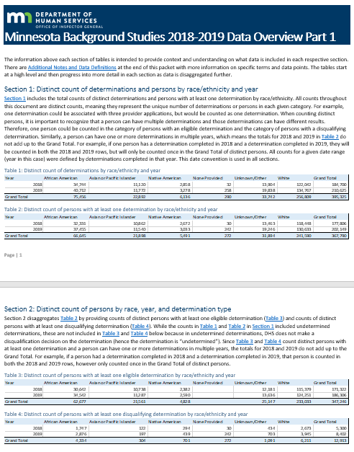
Insights from Data Overview 1: Determinations
5% of determinations completed in 2018 and 2019 resulted in a disqualification.
3.5% of distinct persons who received a determination were disqualified (one person can have multiple disqualifying determinations for when affiliated with more than one provider).
Approximately 20% increase in the number of distinct persons with a determination from 2018 to 2019.
Approximately 70% increase in the number of distinct persons with a disqualifying determination in the same period.
People of color represented 26% of all distinct persons with a determination completed in 2018 and 2019; and 41% of all distinct persons with a disqualifying determination in the same period.
Home Care Providers, Home and Community Based Services Providers, and Personal Care Provider Organizations represented roughly 52% of all distinct persons with a determination completed in 2018 and 2019.
Notes:
-People of color includes all people in the African American, Asian Pacific Islander, and Native American categories

Slide 5
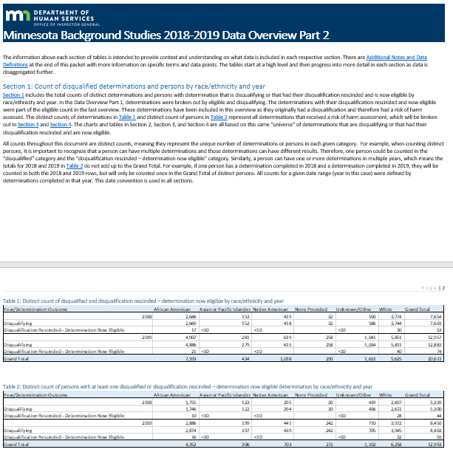
Insights from Data Overview 2: Risk of Harm
Approximately 30% of all disqualifying determinations had more than one disqualifying crime or conduct.
30% of distinct persons with a disqualifying determination were allowed to work with no supervision; and 37% were allowed to work under supervision during their reconsideration period based on their risk of harm analysis.
About 10% of distinct white persons with a disqualifying determination were ordered immediately removed compared to about 12% of distinct persons of color with a disqualifying determination based on their risk of harm analysis.

Slide 6
Thank You!

